Slide 1

Contributory Market Insights Alerts
Paid Closed Severity - Window
Fido Analytics

Slide 2
Introduction
Data aggregation process
Zero rates analysis
Impact of the Covid-19
Calculate alerts for abnormal high/low severity
Fido Analytics

Slide 3
Data aggregation
select w.year_month,w.ambest_sk,window_sk,w.coverage_type_sk, w.policy_state_sk, a.shopgroup_sk,a.groupname,
sum(w.claim_reported_count) as claim_reported_count_window,
sum(w.claim_paid_count) as paid_count_window,
sum(w.claim_paid_closed_count) as claim_paid_closed_count_window,
sum(w.daystoclose_adj) as daystoclose_adj_window,
sum(w.daystopay_adj) as daystopay_adj_window,
sum(w.paid_closed_claim_amount) as paid_closed_claim_amount_window
from fact_imi_auto_claim_window w
inner join dim_imi_ambest a on a.ambest_sk = w.ambest_sk
where cy_date_sk >=20200401 and cy_date_sk <= 20201231 and coverage_type_sk in (1,2,3,8)
group by year_month,w.ambest_sk,coverage_type_sk, policy_state_sk, window_sk,a.shopgroup_sk, a.groupname
fact_imi_auto_claim_window
Inner join dim_imi_ambest a on ambest_sk
coverage_type_sk in (1,2,3,8)- BI, CO, CP, PD
Product: LN CLUE( CLUE auto, claims discovery)
Fido Analytics

Slide 4
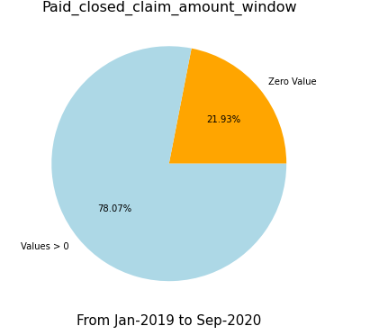
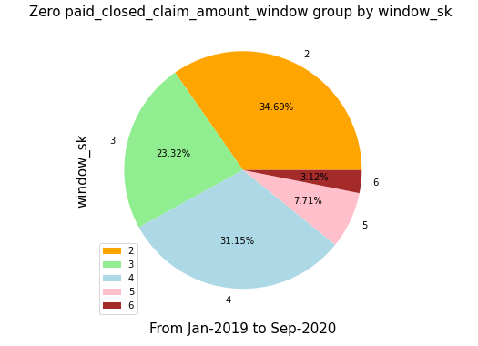
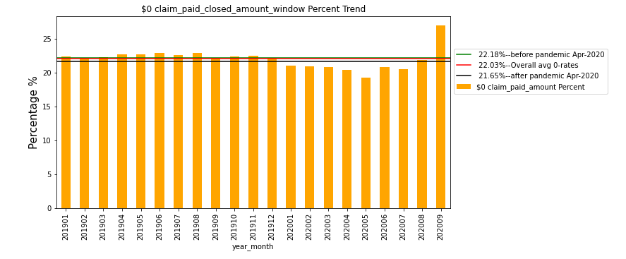
Zero Rates

Slide 5
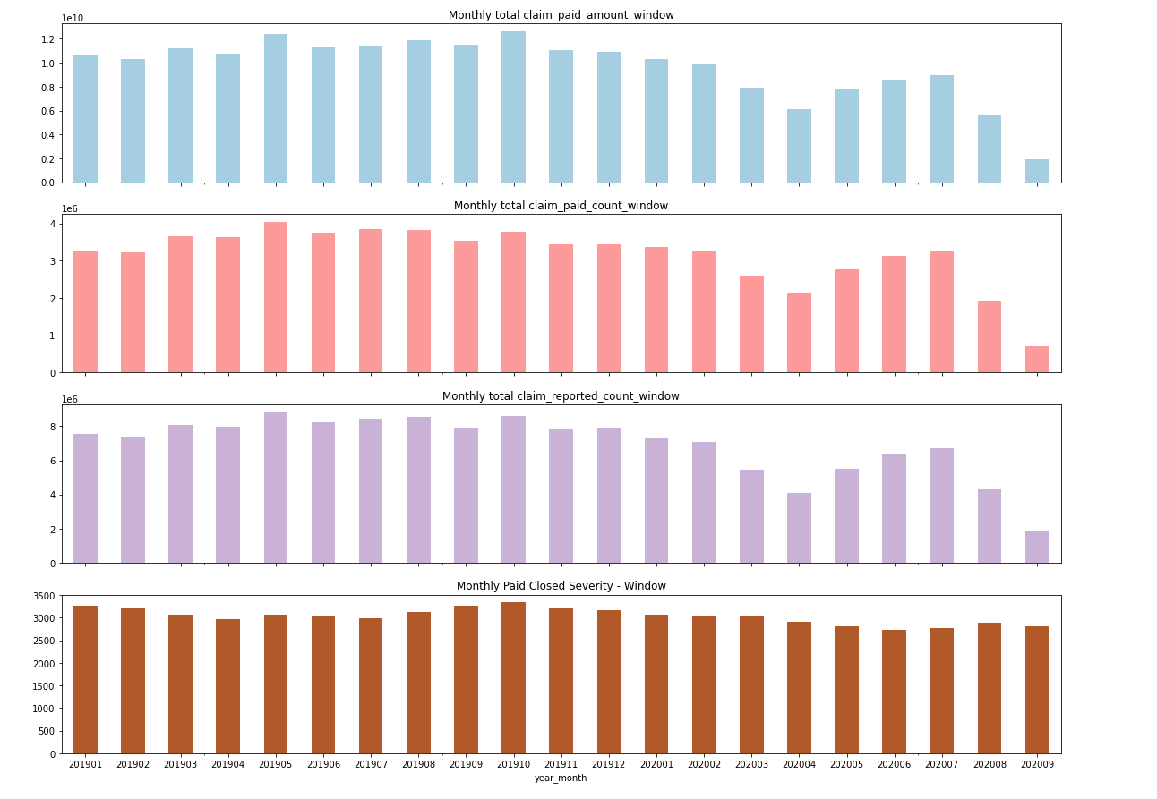
Impact of Covid-19
APR 2020
The max year_month we have in the database
Sep-2020 is There are still delays for Sep-2020
The data is heavily impacted by Covid-19, thus need to treat the data from Apr-2020 to Sep-2020 separately

Slide 6
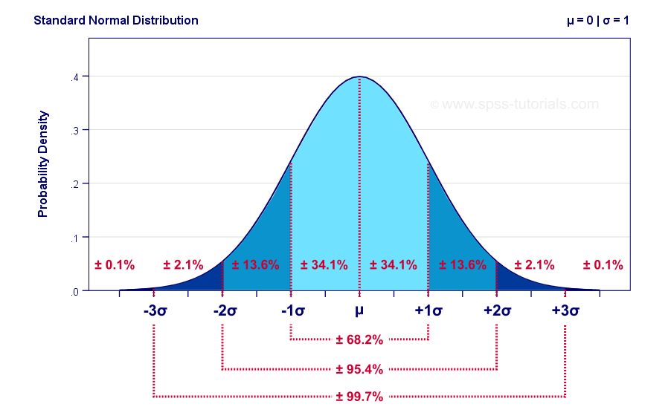
How to calculate alerts for extreme values?
Based on past 5 months trend, for each claim:
Set lower-bound: μ - 5 σ
Values < lower-bound is considered as low values
Set upper-bound : μ + 5 σ
Values > upper-bound are considered as high values

Slide 7
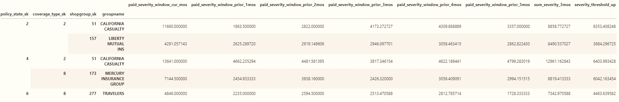
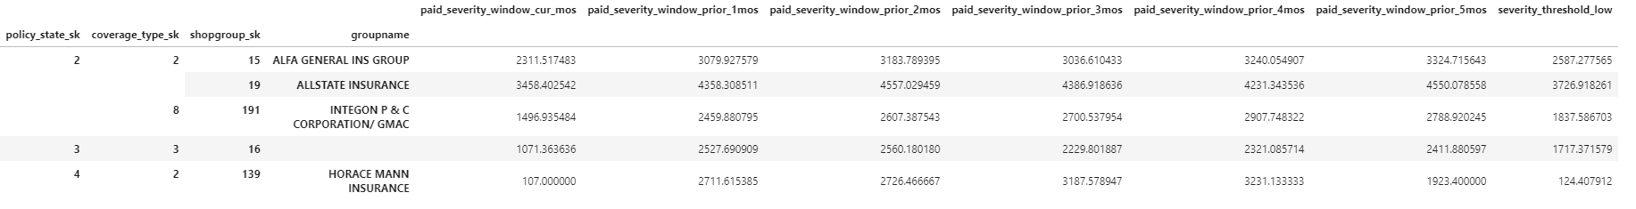
Looking into alerts
Should below high value receive alerts?
Should below high value receive alerts?
Fido Analytics

Slide 8
What’s next?
Same alerts detection method will be applied to Reported Frequency – Window
Closed counts, reported counts
Discuss the floors to narrow the number of the alerts
Fido Analytics

Slide 9
Thank you!
Fido Analytics

